Slide 1
Pipelining + Addressing Modes
Week – 7
19-23 March 2018

Slide 2
Paper Pattern – Mid-Term (Total Marks = 30)
Short Questions – 6 or 7 (2 marks each)
Long question – 1 or 2 (5 marks each)
Numerical question – 1 or 2 (5 marks each)

Slide 3
Topics to Cover
‘Organizational techniques’ to Improve Processor Speed
Pipelining
Superscalar
Super-pipeline
Addressing Modes
Immediate Addressing
Register Addressing
Direct Addressing
Indirect Addressing
Register Indirect Addressing
See Morris Page. 302

Slide 4
1. Multi-Stage Pipeline
Instruction Format
Opcode
Address
Instruction pipelining is an organizational approach, to improve the processor performance.
As in a pipeline, new inputs are accepted at one end before previously accepted inputs appear as output at the other end.
Each step in the instruction cycle (fetch -> decode -> execute) takes at least one tick of the system clock, called a clock cycle.
But this does not mean that the processor must wait until all steps are completed before beginning to process the next instruction.
The processor can execute the steps in parallel, a technique known as pipelining. (e.g. overlapping of instruction processing steps)

Slide 5
Six-Stages of an Instruction
The six-stages of an instruction are listed below:
Fetch instruction (FI): Read the next expected instruction into a buffer.
Decode instruction (DI): Determine the opcode and the operand.
Calculate operands (CO): Calculate the effective address of each source operand. This may involve address calculation.
Fetch operand (FO): Fetch each operand from memory to register.
Execute instruction (EI): Perform the indicated operation/result.
Write operand (WO): Store the result in memory.

Slide 6
Non-Pipelined Instruction Execution (Fig. Next)
Let’s assume that each execution stage in the processor requires a single clock cycle.
Figure uses a grid to represent a six-stage non-pipelined processor.
When instruction I-1 has finished stage S6, instruction I-2 begins.
Twelve clock cycles are required to execute the two instructions.
In other words, for k execution stages, n instructions require (n*k) cycles to process.
Of course, it represents a major waste of CPU resources because each stage is used only one-sixth of the time.

Slide 7
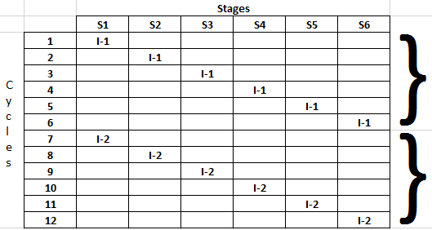
6-Stage Non-Pipelined Instruction Execution
1st instruction
2nd instruction
(n*k) Cycles => 12 cycles

Slide 8
Pipelined Execution (Fig. Next Slide)
If, on the other hand, a processor supports pipelining, a new instruction can enter stage S1 during the second clock cycle.
Meanwhile, the first instruction has entered stage S2.
This enables the overlapped execution of the two instructions.
In Figure, two instructions I-1 and I-2, are shown progressing through the pipeline.
I-2 enters stage S1 as soon as I-1 has moved to stage S2.
As a result, only seven clock cycles are required to execute I-1 & I-2.
When the pipelining is full, all six stages are in use all the time.
In general, for k execution stages, n instructions require k+(n-1) cycles.

Slide 9
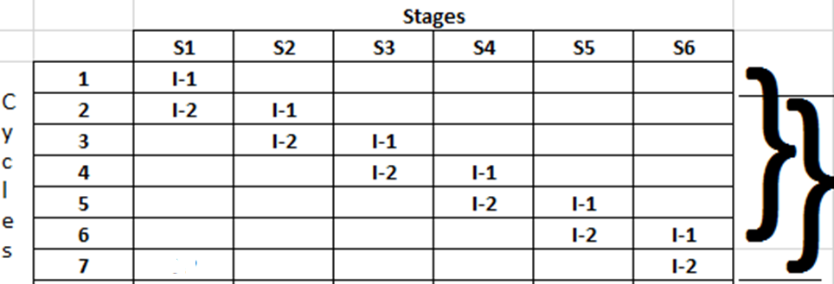
6-Stage Pipelined Instruction Execution
New
Instruction
executed
Per cycle.
k + (n-1) = cycles => 7 cycles
Q. In a six-stage pipelined processor, how many instructions can be executed in 12 clock cycles? Ans: 7.

Slide 10
2. Superscalar Architecture (Fig. Next Slide)
A superscalar processor has two or more execution pipelines, making it possible for two instructions to be in the execution stage at the same time.
In the previous pipeline example, we assumed that the ‘instruction execution’ stage (S4) required a single clock cycle.
That was an overly simplistic approach.
What would happen if stage S4 required two clock cycles?
Then a bottleneck would occur, as shown in Figure next slide.
Instruction I-2 cannot enter stage S4 until I-1 has completed the stage, so I-2 has to wait one more cycle before entering stage S4.
For n-pipelines, n-instructions can execute during the same clock cycle.
Q. Define a way of increasing the efficiency of the pipeline. Ans: Superscalar approach.

Slide 11
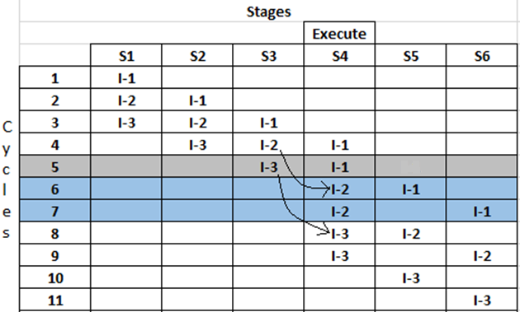
Without Super-Scalar Pipelining
As more instructions enter the pipeline, wasted cycles occur (shaded in grey & blue).
In general, for k stages (where one stage requires 2 execute cycles), n instruction require (k + 2n – 1) cycles to process.
One cycle Wait for I-2
Two cycles Wait for I-3
k+(2n-1) Cycles
=> 11 cycles

Slide 12
With Super-Scalar Pipelining (Fig. Next Slide)
When a superscalar processor design is used, multiple instructions can be in the execution stage at the same time.
For n-pipelines, n-instructions can execute during the same clock cycle.
Let us introduce a second pipeline (superscalar) into our 6-staged pipeline and assume that execution stage S4 requires two clock cycles.
In Figure, odd-numbered instructions enter the u-pipeline and even-numbered instructions enter the v-pipeline.
This removes the wasted cycles, and it is now possible to process n instructions in (k + n) cycles.

Slide 13
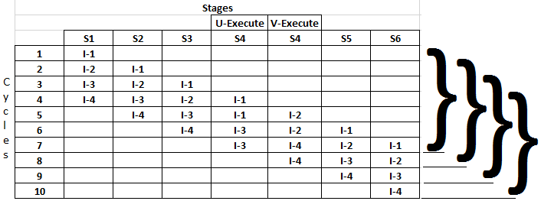
Two Pipelined Stages (Superscalar)
Every next
Instruction
Executed
Per clock cycle
(k + n) Cycles = > 10 cycles

Slide 14
3. Super-Pipeline
In a Super-pipeline, many pipeline stages need less than half a clock cycle.
Super-pipeline is the breaking of stages of a given pipeline into smaller stages. (thus making the pipeline deeper) in an attempt to shorten the clock period and thus enhancing the instruction throughput by keeping more and more instructions in flight at a time.

Slide 15
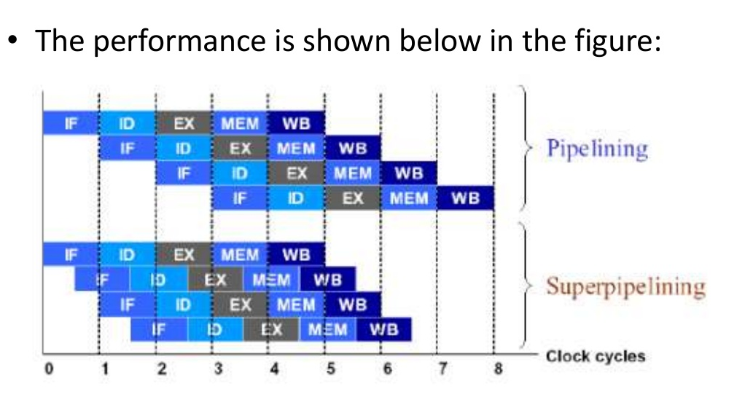
Super-pipeline Performance

Slide 16
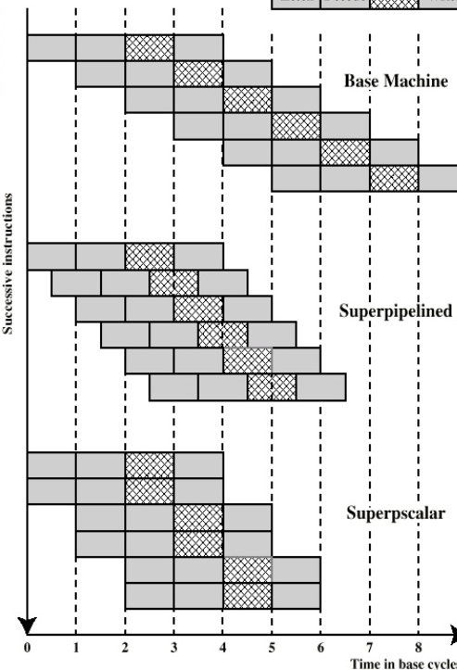
‘Super-Scalar’ VS ‘Super-Pipeline’
Simple pipeline system performs only one pipeline stage per clock cycle.
Super-pipeline system is capable of performing two pipeline stages per clock cycle.
Super-scalar performs only one pipeline stage per clock stage in each parallel pipeline.

Slide 17
Pipeline Hazards/Problems
Limits to Pipelining, Hazards prevent next instruction from executing during its designated clock cycles.
Structural hazards: Hardware cannot support some combination of instructions (single processor will limit to machine level parallelism).
Control hazards: Pipelining of branches causes later instruction fetches to wait for the result of the branch. (limited ILP)
Data hazards: Instruction depends on result of prior instruction still in the pipeline (data dependency).
These might result in pipeline ‘stalls’ or ‘bubbles’ in the pipeline.

Slide 18
Preparatory Questions (Pipelining)
Q1. What is the ‘instruction pipelining’? How can we pipeline instructions?
Q2. In a six-stage pipelined processor, how many instructions can be executed in 18 clock cycles?
Q3. What is a ‘superscalar’ pipeline? How does it improve processor performance?
Q4. What is a ‘superpipeline’? How does it differ from a normal pipeline?
Q5. What are the ‘hazards’ to pipelining?

Slide 19
Topics to Cover
Addressing Modes
Immediate Addressing
Register Addressing
Direct Addressing
Indirect Addressing
Register Indirect Addressing

Slide 20
13.1 Addressing Modes
The address field or fields in a typical instruction format are relatively small.
We would like to be able to reference a large range of locations in main memory or, for some systems, virtual memory.
To achieve this objective, a variety of addressing techniques has been employed.
The mode field in the instruction format determines which addressing mode is to be used.
They all involve some trade-off.
Opcode
Address
Word = instruction

Slide 21
Types of Addressing Modes
The most common addressing techniques, or modes (used in RISC) are:
We use the following notation here:
A = contents of an address field in the instruction
R = contents of an address field in the instruction that refers to a register
EA = actual (effective) address of the location containing the referenced operand
(X) = contents of memory location X or register X
Immediate addressing | Direct addressing | Indirect addressing
Register addressing | Register indirect

Slide 22
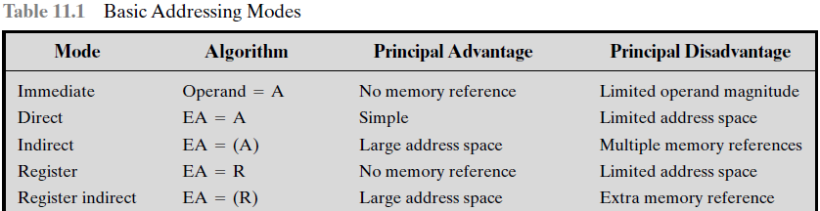
Basic Addressing Modes
In a system without virtual memory, the effective address (EA) will be either a main memory address or a register.
In a virtual memory system, the effective address is a virtual address or a register.

Slide 23
1. Immediate Addressing
Immediate addressing is the simplest form of addressing, in which the operand value is present in the instruction
Operand = A
This mode can be used to define and use constants or set initial values of variables. Example: mov AX, 45h
The advantage of immediate addressing is that no memory reference other than the instruction fetch is required to obtain the operand, thus saving one memory or cache cycle in the instruction cycle.
The disadvantage is that the size of the number is restricted to the size of the address field, which, in most instruction sets, is small compared with the word length.

Slide 24
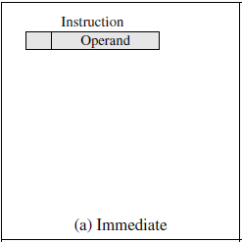
(a) Immediate Addressing Mode

Slide 25
2. Register Addressing
Register addressing is similar to direct addressing. Example: mov AX,BX
The only difference is that the address field refers to a register rather than a main memory address:
EA = R
Typically, an address field that references registers will be of ‘5 bits’, so that a total of 32 general-purpose registers can be referenced.
The advantages of register addressing are that: (1) only a small address field is needed in the instruction, and (2) no time-consuming memory references are required, coz register access time is less.
The disadvantage is that the address space is very limited.

Slide 26
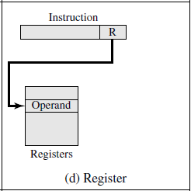
(b) Register Addressing

Slide 27
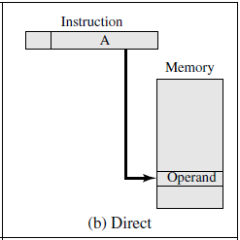
3. Direct Addressing
Direct addressing, the address field contains the ‘effective address’ of the operand:
EA = A
Adv: It requires only one memory reference and no special calculation.
Disadvantage: The limitations is that it provides only a limited address space.
‘One clock cycle’ is required for fetch.
Example: Var1 db 100h; mov AX, Var1

Slide 28
4. Indirect Addressing
With ‘direct addressing’ the length of the address field is usually less than the word length, thus limiting the address range.
One solution is to have the address field refer to the address of a word in memory, which in turn contains a full-length address of the operand.
This is known as indirect addressing:
EA = (A)
As defined earlier, the parentheses () are to mean [contents of].
Example: Var1 db 10h, 20h; mov SI, offset var1; mov AL, [SI + 1]

Slide 29
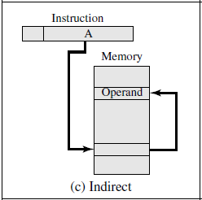
(d) Indirect Addressing
The advantage of this approach is that for a word length of N-bits, an address space of 2^{N} is now available. (thus we can now access higher memory locations)
The disadvantage is that instruction execution requires two memory references to fetch the operand: one to get its address and a second to get its value.
Operand Address

Slide 30
5. Register Indirect Addressing
Just as register address is analogous to direct addressing, register indirect addressing is analogous to indirect addressing.
In both cases, the only difference is whether the address field refers to a memory location or a register.
Thus, for register indirect address,
EA = (R)
Advantages: The address space limitation (limited range of addresses) of the address field is overcome by having that field refer to a word-length location containing an address.
In addition, register indirect addressing uses one less memory reference than indirect addressing. (saves one clock cycle)

Slide 31
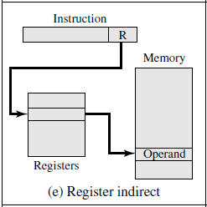
(e) Register Indirect Addressing
Operand Address

Slide 32
Preparatory Question (Addressing Modes)
Briefly define ‘immediate addressing’.
Briefly define ‘direct addressing’.
Briefly define ‘indirect addressing’.
Briefly define ‘register addressing’
Briefly define ‘register indirect addressing’.
What is the advantage of ‘indirect addressing’?
The End – before Mids.

